Slide 1
Transformations and viewing in 2D
2D transformations
Windows and viewports
Clipping

Slide 2
2D Transformations
Translation
Rotation
Scaling
Reflection
Others

Slide 3
2D Transformations, cont’d
A new point (x’, y’) shall be generated from an existing point (x, y)
E.g.
* for a line - the two endpoints
* for a polygon - the vertices
* for a circle - the midpoint

Slide 4
Translation
If T_{x} and T_{y} corresponds to the relative movements in the two main directions, then
x’ = x + T_{x}
y’ = y + T_{y}

Slide 5
Rotation
Additional specifications are required, e.g.
rotation relative to origin
an angle of rotation, θ
counterclockwise (or clockwise)
Then
x’ = x*cos θ - y*sin θ
y’ = x*sin θ + y*cos θ

Slide 6
Scaling
Additional requirement:
scaling relative to origin
Then
x’ = x*S_{x}
y’ = y*S_{y}
Note! S_{x} and S_{y} are normally the same.

Slide 7
2D Transformations, cont’d
A sequence of transformations can be combined into one transformation.
Then, the order is important
Often more convienient to use matrix representation of the transformations, especially if they are going to be combined.

Slide 8
Homogeneous Coordinate System
Any 2D transformation can be described uniquely by a 3x3 matrix, if the Cartesian coordinates (x, y) is represented by the homogeneous coordinate triple (x_{w}, y_{w}, w),
where x=x_{w}/w, y=y_{w}/w and w can be any real value ≠ 0, for simplicity w=1 is used here

Slide 9
Matrix representation
Any 2D transformation can be represented by a 3x3 matrix uniquely, if the Cartesian coordinates are transformed into coordinates in the 3D homogeneous coordinate system.

Slide 10
Homogeneous Matrix Representation
The transformation
(x, y) => (x’, y’)
is generally represented by

Slide 11
Translation Matrix
Moving T_{x} in x-direction and T_{y} in y-direction:

Slide 12
Rotation Matrix
Rotate θ degrees about origin in counter-clockwise direction:

Slide 13
Scaling Matrix
Scaling with factors S_{x} and S_{y} relative to origin:

Slide 14
Combining simple transformations
More complex transformations can be combined and expressed by using one single 3x3 matrix, which is the product of all the combined simple matrices.
Note! The order between the matrices is crucial!

Slide 15
Example with a combined transformation
A point (x, y) shall be rotated θ degrees in clockwise direction about the point (R_{x},R_{y}).
Three steps:
1) Move (R_{x}, R_{y}) to origin
2) Rotate θ degrees about origin
3) Move back to (R_{x}, R_{y})

Slide 16
Example, step 1)

Slide 17
Example, step 2)

Slide 18
Example, step 3)

Slide 19
Example, result

Slide 20
Scaling Example
Also scaling can be done relative to an arbitrary point (R_{x}, R_{y}):

Slide 21
Some reflection matrices

Slide 22
Viewing in 2D
Generally, an image is defined in a world coordinate system, WC
To restrict the image in WC a window is defined, typically of rectangular shape
a) The process to transform the window (in WC) to a viewport in device coordinates is called the viewing transformation. Also, local viewport coordinates (VC) can be used within the viewport.

Slide 23
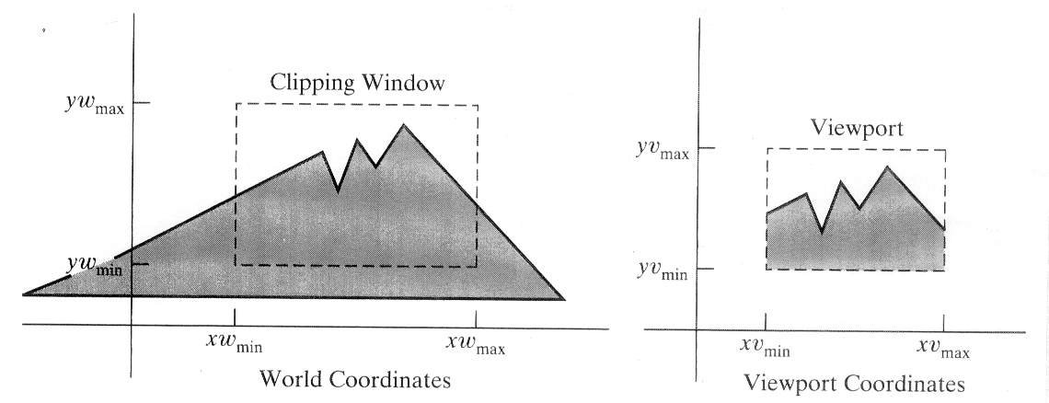
Viewing in 2D, cont’d
b) The process to eliminate image parts outside the window is called clipping.

Slide 24
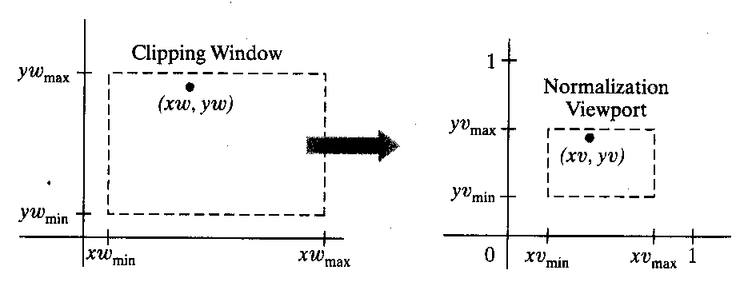
Viewing Transformation
For a point (x_{w},y_{w}) in the window to have same relative position in the viewport, (x_{v},y_{v}), the following conditions have to be fulfilled (proportionality):

Slide 25
Viewing Coordinates

Slide 26
Clipping
When specifying a window some parts of the image are inside the window (visible) and some are not (invisible).
Clipping: a process that divides each element of an image in its visible and invisible parts, and then throw away the invisible ones.

Slide 27
Clipping different objects
Point clipping
A point (x,y) is visible if
x_{min}≤x≤x_{max} and y_{min}≤y≤y_{max}
Line clipping
Polygon clipping
Curve clipping
Text clipping

Slide 28
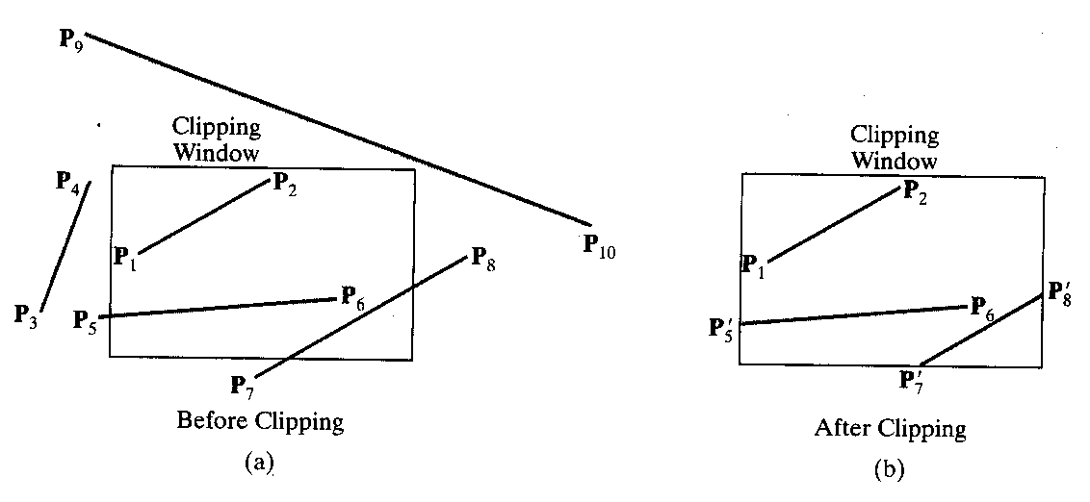
Line Clipping
Too time consuming to check each point of a line; larger parts of the line must be clipped in each step

Slide 29
Cohen-Sutherland’s Line Clipping Algorithm
Main idea: At most one visible part per line (if a rectangular window) means that it’s enough to decide the endpoints of the visible part.
Extend the edges of the window giving 9 regions with a unique 4-bit code related to each of them, where
Bit 1 corresponds to Top
Bit 2 corresponds to Bottom
Bit 3 corresponds to Right
Bit 4 corresponds to Left

Slide 30
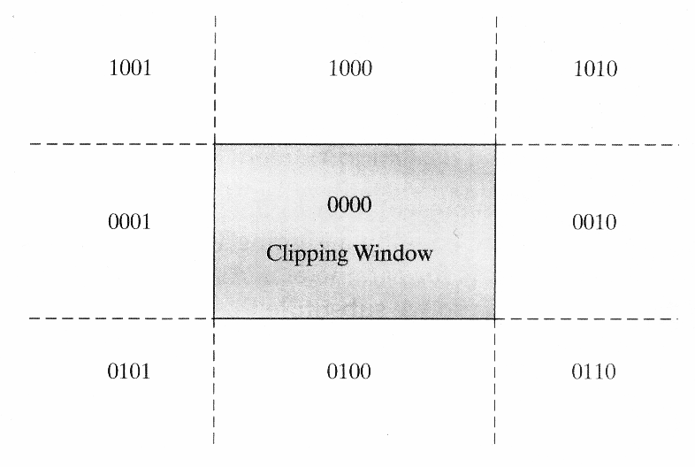
Algorithm, cont’d
The endpoints of each line are then assigned a code corresponding to the region to which they belong

Slide 31
Algorithm, cont’d
The following three steps are then repeated for each line:
if the codes for both endpoints are equal to zero (0000)=> the line is inside the window (visible)
if the logical intersection (AND) between the endpoint codes is not equal to zero => the line is outside (invisible)

Slide 32
Algorithm, cont’d
3) else divide the line at an intersection with a window edge (or its extension!) and throw away the outside part, update the code for the new endpoint and repeat with the new line from 1)
Step 3) is done as follows

Slide 33
Algorithm, step 3)
Assume endpoints (x₁, y₁) and (x₂, y₂).
The line equation can then be written:
y=y₁ + k*(x - x₁), k=(y₂ - y₁)/(x₂ - x₁)
When clipping against x=x_{min} or x=x_{max}, the x-coordinate of the intersection is given, and the corresponding y is then calculated from the above equation.

Slide 34
Algorithm, step 3), cont’d
Correspondingly, when clipping against y=y_{min} and y=y_{max} the line equation is rewritten to calculate the x-coordinate of the intersection point:
y=y₁ + k*(x - x₁) => x=x₁ + 1/k*(y - y₁)

Slide 35
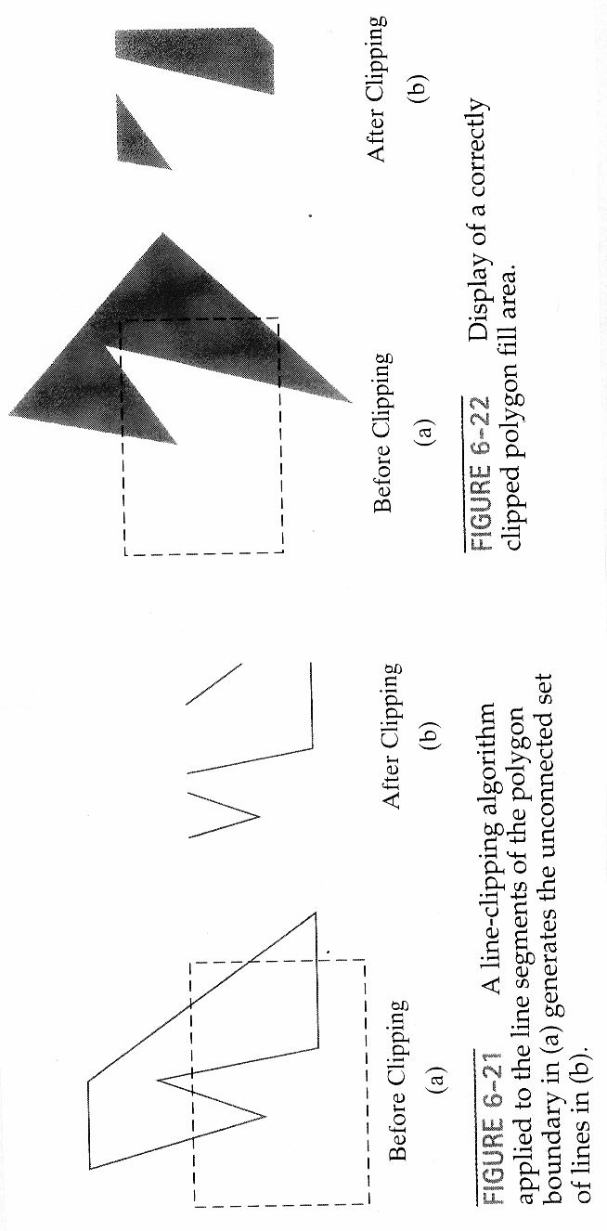
Polygon Clipping
In principle, line clipping could be used to clip
polygons as well. The major problem with that
approach is to keep track of the parts belonging
to the polygon and possible polygon filling.

Slide 36
Polygon Clipping, cont’d
A polygon clipping method should first
generate one or more closed areas
based on an input sequence of the
vertices of the original polygon. The
output from the clipping step is a new
sequence of vertices defining the
resulting polygon

Slide 37
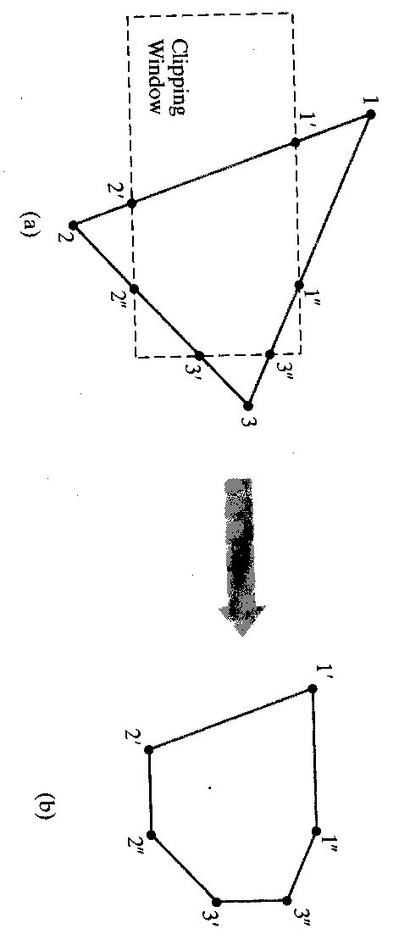
Polygon Clipping, cont’d
Finally, the new polygon is scan converted for
correct area fill

Slide 38
Sutherland-Hodgeman’s Polygon Clipping Algorithm
Best with convex polygons.
Basic principle: Clip the polygon against one window edge at a time
=> 4 clippers are required (one for each edge)
The initial input sequence of vertices will
then be updated successively during each
of the four clipping steps.

Slide 39
Algorithm
Four possible cases are recognized when
processing the polygon vertices in
sequence around the polygon perimeter
depending on the pairwise relation
between two successive vertices:

Slide 40
Algorithm, cont’d
out -> in: intersection point and second vertex -> vertex list
in -> in: second vertex -> vertex list
in -> out: intersection point -> vertex list
out -> out: nothing -> vertex list
Finally, the last and the first vertices are
connected.

Slide 41
Algorithm, cont’d
Concave polygons resulting in more than one area section will have a connecting line on the window boundary!

Slide 42
Curve Clipping
Similar methods as for lines and polygons but more processing is required due to non-linear equations.
For a curved object a bounding rectangle can be used to make a first test for overlap.

Slide 43
Text Clipping
In general, methods depend on how characters are represented
Three strategies can be followed:
all-or-none string clipping
  use a bounding rectangle for the string
all-or-none character clipping
  use a bounding rectangle for the character
individual character clipping
  like line/curve clipping (outlined char’s)
  compare individual pixels (bit-mapped)

Slide 44
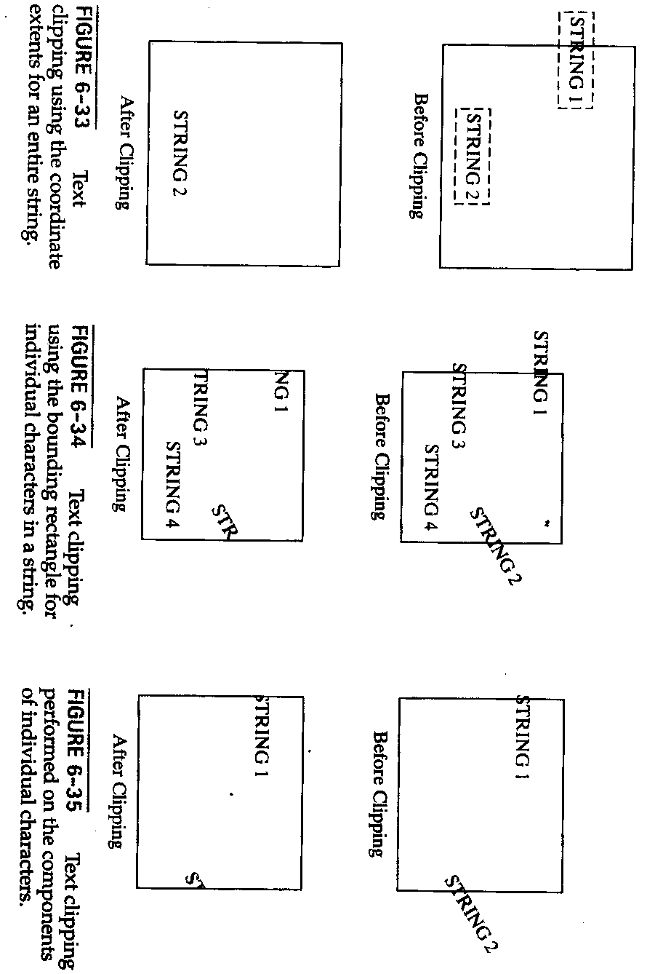
Text Clipping,examples

Slide 45
External Clipping
So far the clipping discussion has been about what is specified as internal clipping (throw away outside parts).
But also external clipping (throw away inside parts) is commonly used, e.g. in multiple-window systems which are standard in today’s GUI’s

